Slide 1

Hospital Management System
BY: SRIHARIHARAN DATE 21/10/2024

Slide 2
PROJECT DESCRIPTION
Scope:
This HMS project can be used by small clinics, medium-sized hospitals, and large healthcare facilities. It can also be scaled to accommodate additional features such as telemedicine, online consultation, and mobile app integration.
Objectives:
To provide seamless patient management and improve the patient experience.
To automate the hospital's administrative tasks to reduce manual effort.
To maintain accurate records of patients, treatments, and hospital resources.
To provide real-time access to medical records, reducing wait times for doctors and patients.

Slide 3
AIM OF THE PROJECT
The aim of a Hospital Management System (HMS) is to streamline and automate the operations of a hospital or healthcare facility to improve efficiency, accuracy, and patient care. Here are the key objectives of an HMS
Automate workflows: Reduce manual work and improve coordination across departments
Secure data: Protect sensitive patient, staff, and hospital information
Improve patient experience: Design a system to improve the patient experience
Reduce operational costs: Reduce unnecessary expenses and efficiently allocate resources
Provide analytics: Provide reports and analytics for management to aid in decision-making
Improve resource allocation: Optimize resource allocation and reduce wait times

Slide 4
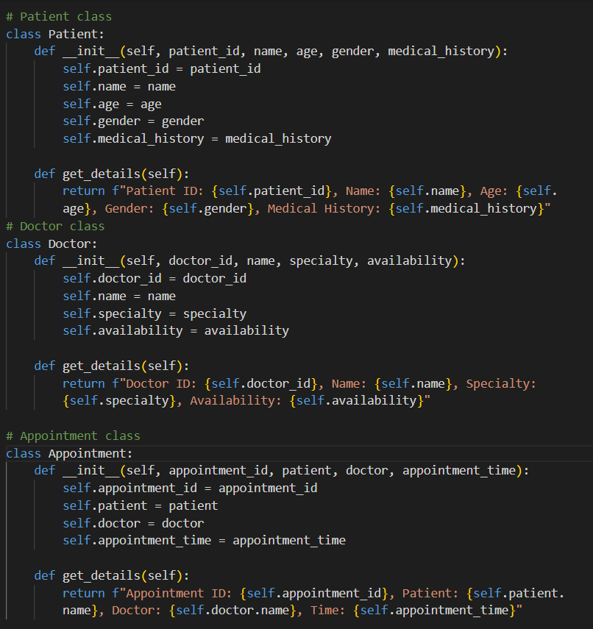
CODE IMPLEMENTATION
Class Definitions:The code defines four main classes: Patient, Doctor, Appointment, and Hospital. Each class represents an entity in the hospital system, and they are interconnected
Patient Class:Attributes (Variables):
Patient_id: A unique identifier for the patient.name: The patient's
Name.age: The patient's
Age.gender: The patient's Gender.
Medical_history: The patient's medical history.
Methods:
__init__: This is the constructor, called when a Patient object is created. It initializes the patient’s details.
get_details: This method returns a formatted string with the patient's details

Slide 5
CODE IMPLEMENTATION
Doctor Class:
Attributes (Variables):
doctor_id: A unique identifier for the doctor.
name: The doctor's name.
specialty: The doctor's area of specialization (e.g., Cardiologist).
availability: The doctor's working hours or availability.
Methods:
__init__: Constructor for initializing the doctor's details.
get_details: Returns a formatted string with the doctor's details.

Slide 6
CODE IMPLEMENTATION
Appointment Class:
Attributes (Variables):
Appointment_id: A unique identifier for the appointment.
Patient: This links to a Patient object.
Doctor: This links to a Doctor object.
Appointment_time: The time of the appointment.
Methods:
__init__: Constructor for initializing appointment details.
get_details: Returns a formatted string with the appointment's details, including the patient’s name, doctor's name, and the time.

Slide 7
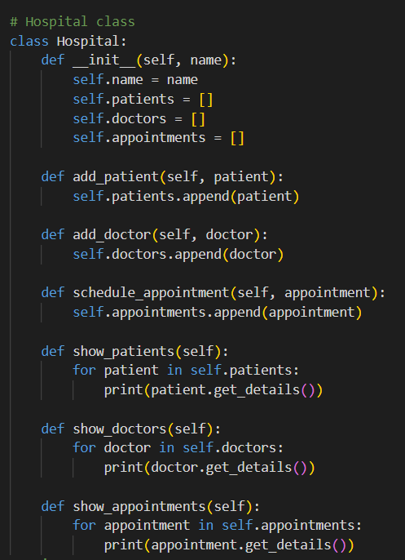
CODE IMPLEMENTATION
Hospital Class:
Attributes (Variables):
Name: The name of the hospital.
Patients: A list to store the Patient objects.
Doctors: A list to store the Doctor objects.
Appointments: A list to store the Appointment objects.
Methods:
__init__: Constructor that initializes the hospital's name and creates empty lists for patients, doctors, and appointments.
Add_patient: Adds a Patient object to the list of patients.
Add_doctor: Adds a Doctor object to the list of doctors.
schedule_appointment: Adds an Appointment object to the list of appointments.
show_patients: Loops through the list of patients and prints their details using the get_details method from the Patient class.
show_doctors: Loops through the list of doctors and prints their details using the get_details method from the Doctor class.
show_appointments: Loops through the list of appointments and prints their details using the get_details method from the Appointment class.

Slide 8
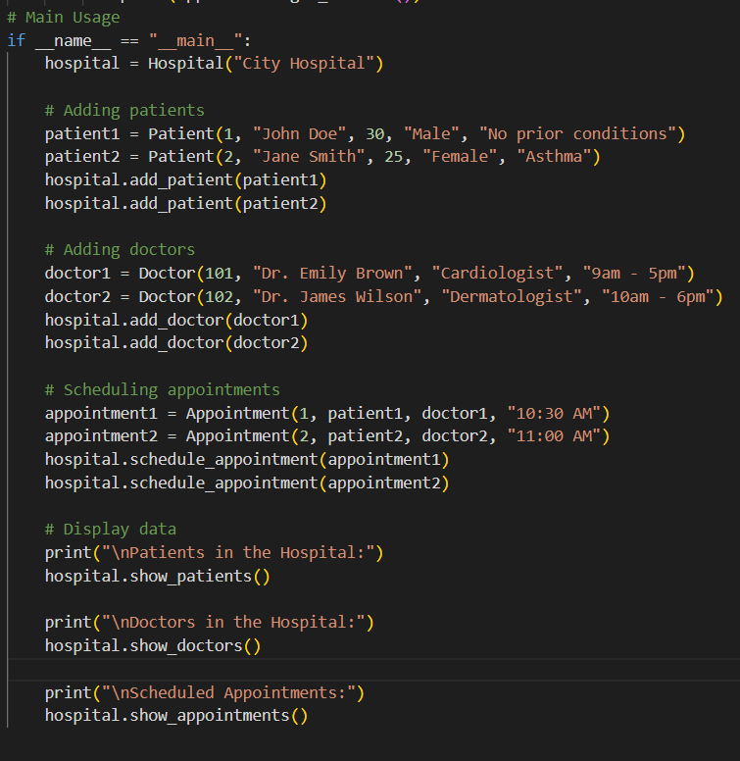
CODE IMPLEMENTATION
Example Usage:
First, a Hospital object called hospital is created.
Then, two Patient objects (patient1 and patient2) are created and added to the hospital using the add_patient method.
Two Doctor objects (doctor1 and doctor2) are created and added to the hospital using the add_doctor method.
Two Appointment objects are created, associating a patient with a doctor, and scheduled in the hospital using the schedule_appointment method.
Finally, the details of all patients, doctors, and appointments are displayed using the show_patients, show_doctors, and show_appointments methods.
python

Slide 9
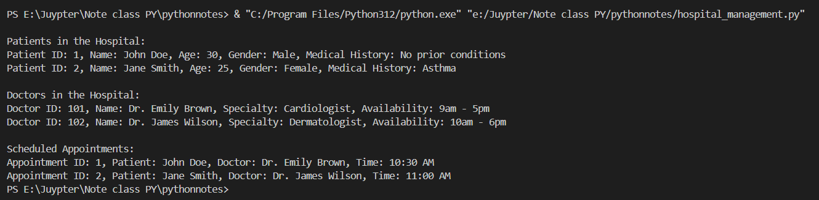
CODE IMPLEMENTATION

Slide 10
Summary of Concepts:
Classes and Objects: This code makes use of object-oriented programming (OOP). Each entity (Patient, Doctor, Appointment, Hospital) is represented by a class, and specific instances are created (objects).
Encapsulation: Information about patients, doctors, and appointments is encapsulated inside their respective classes, accessed through methods.
Lists: The hospital maintains lists of patients, doctors, and appointments, which can grow dynamically.
Composition: The Appointment class uses objects of the Patient and Doctor classes, showing a relationship between different objects.

